Slide 1
Best
Practices
eBird Data Extraction and Processing in R
Notes:
Introduce instructors
Introduce participants: who you are, how you’re hoping to use eBird data (ok, if you’re just curious and don’t have any specific project in mind)

Slide 2
is a an online database of bird observations collected by citizen scientists, providing real-time data about the global distribution and abundance of bird species.
Notes:
Who’s submitted an eBird checklist?
Who’s tried to use eBird data before?

Slide 3
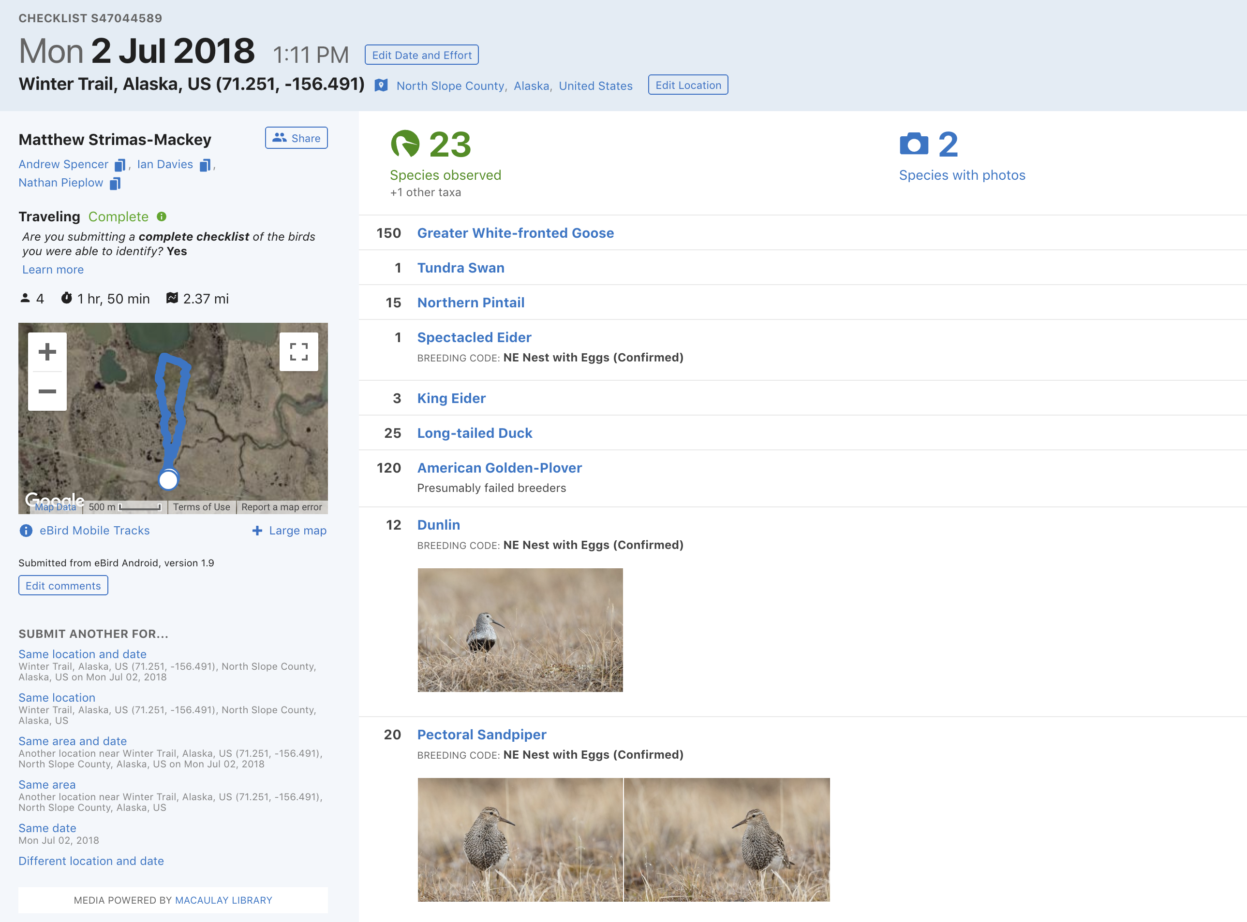
Notes:
All data in eBird are collected in the form of a checklist: a list of all species observed in a single birding event.
This is in contrast to iNaturalist etc.

Slide 4
645 million observations
461,509 eBirders
eBird checklists per month (Thousands)
4,695 cumulative years of effort
10,419 species (98% of bird species)
Notes:
One of the largest repositories of biodiversity data
Program started in 2003 and has seen exponential growth in the number of checklists submitted each month since then

Slide 5
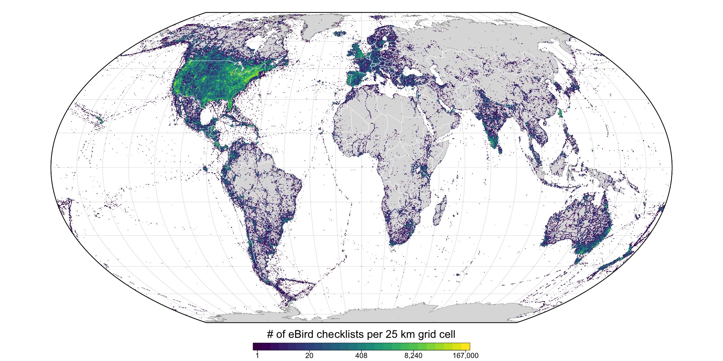
eBird checklists per 25 km grid cell
Notes:
eBird data are global in scope, this map depicts the number of checklists within 25 km grid cells, and you can see that every country on earth is represented in eBird.
eBird started in North America, before going global in 2010, and you can see there is still a US bias in eBird data

Slide 6
How do I access eBird data?
eBird website
1
eBird Status and Trends
2
Accessing raw eBird data
3
Notes:
web: tools for exploring the data
S&T: provides access to distribution models for a suite of North American species
raw: raw eBird data to do your own analyses
Mention GBIF: a degraded form of eBird data, don’t use it because presence only and doesn’t include all fields

Slide 7
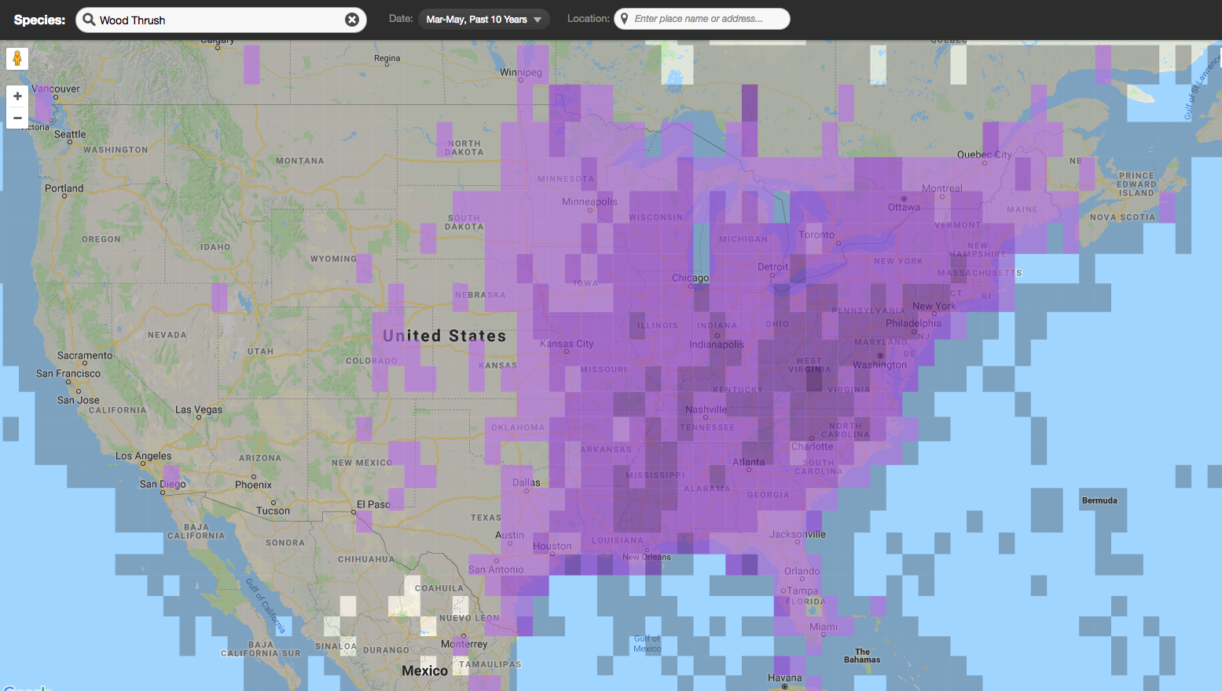

1
Notes:
The eBird website has all sorts of amazing tools for summarizing and visualizing eBird data, which can be super useful for exploratory analysis
eBird frequency maps show the frequency of observation on eBird checklists, in this case for wood thrush

Slide 8
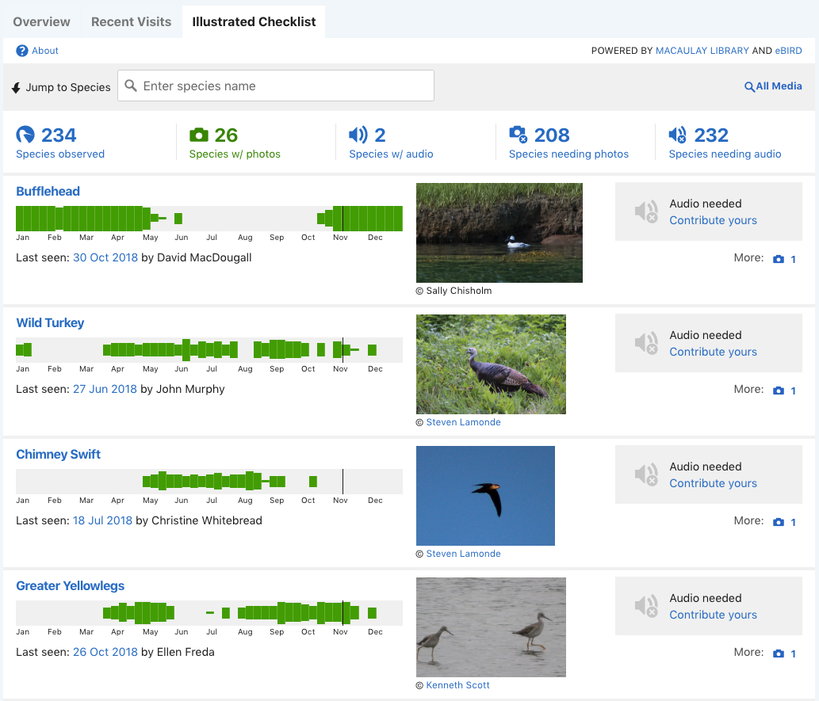
1
Notes:
Illustrated checklists shows what birds are present at what time of year for a specific location. Green bar charts indicate observation frequency throughout the year, with thicker green bars indicating higher occurrence rate on eBird checklists for that week.
EXAMPLES
encourage you to peruse the eBird website

Slide 9
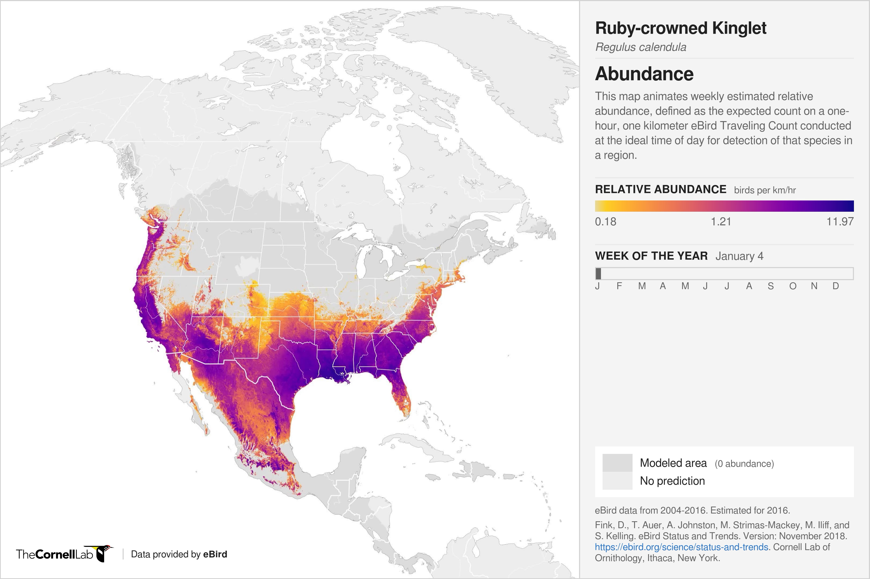
2
Full life cycle models, at high spatiotemporal resolution, of:
abundance
trends
habitat associations
range
Status & Trends
Notes:
eST is a project that uses eBird data to model the distribution, abundance, and trends for a a suite of 122 North American bird species at high spatiotemporal resolution
All the resulting information is available on the eBird website
for example, this map shows the relative abundance of RCKI for each week of the year, throughout the bird's range

Slide 10
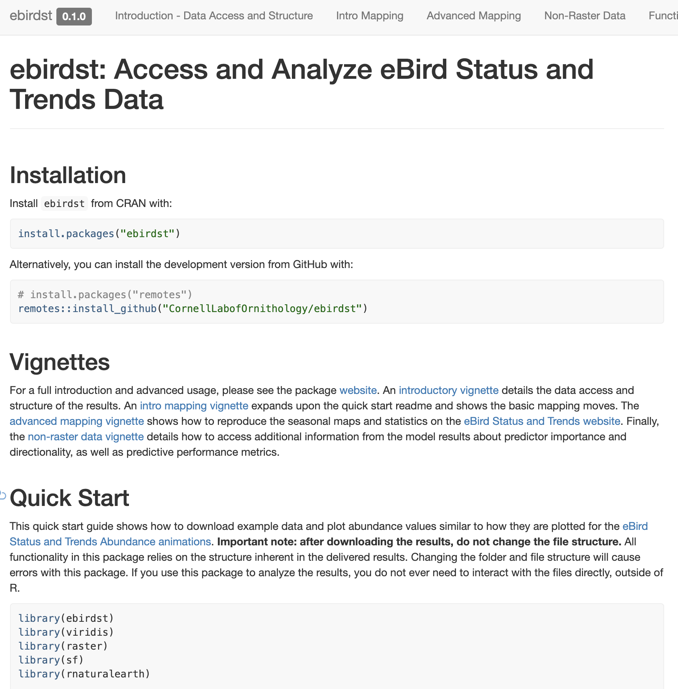
2
Species Distributions and Population Trends with Citizen Science Data
Daniel Fink
Wednesday 4 pm
Summit 4
Working with eBird Status and Trends data products in R
Tom Auer & Daniel Fink
Friday 12-2 pm
Summit 5-6
Notes:
All this stuff is available for viewing through the eBird website for 122 species and that number will expand to 500 species by the end of the year.
Data can also be downloaded if you want to work with it yourself and there's an R package to do that called ebirdst. In some cases you may be able to use this data, rather than having to build your own models and work with the raw data.
Finally, there are two talks on eBird S&T at AOS this year.

Slide 11

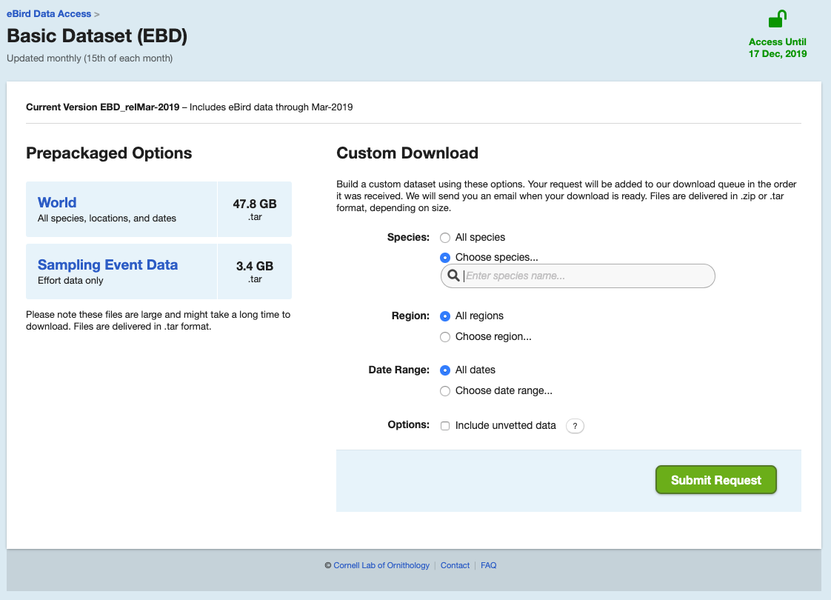
3
!
Notes:
But obviously, you’re here because you want to dive into the data yourselves
EBD is large text file released monthly containing the entire eBird database, with some exceptions (like sensitive species)

Slide 12
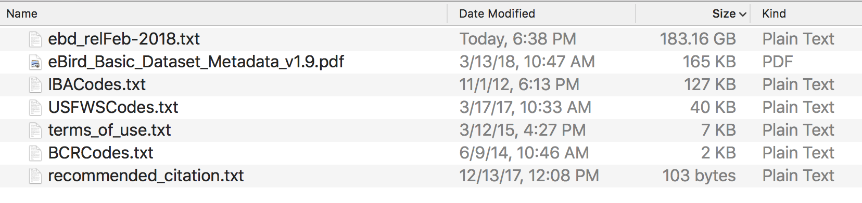
!!!
Notes:
200 GB text file with over 600 million rows of data!

Slide 13



Slide 14



Slide 15
We need to make this FILE
smaller
Notes:
Need to extract just the stuff we need from the file, so it’s small enough to work with in R

Slide 16
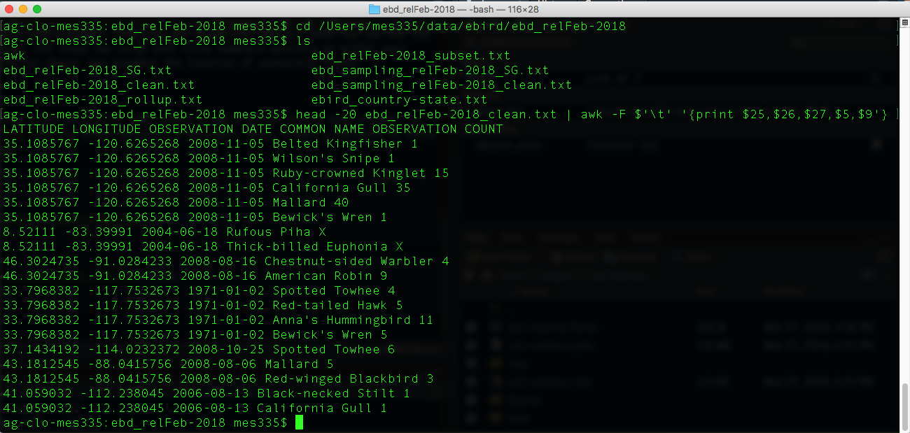

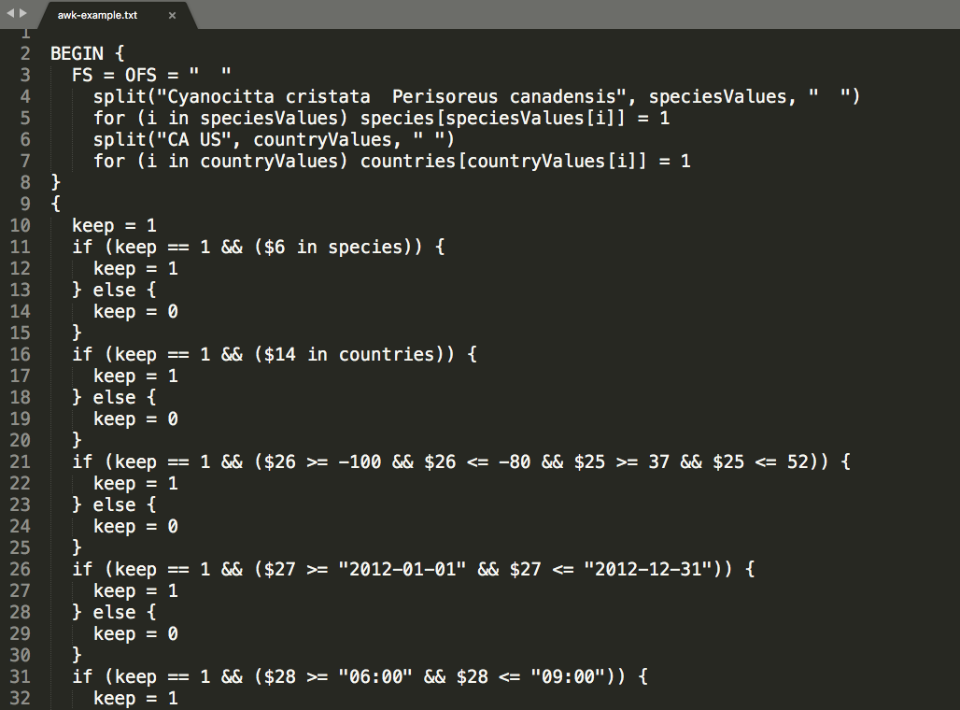

Terminal
AWK
Notes:
There is a programing language called AWK designed for text process
It’s super fast for processing text files, but challenging to learn the syntax and you have to use the terminal, it was invented in the 70s so it's a little archaic

Slide 17
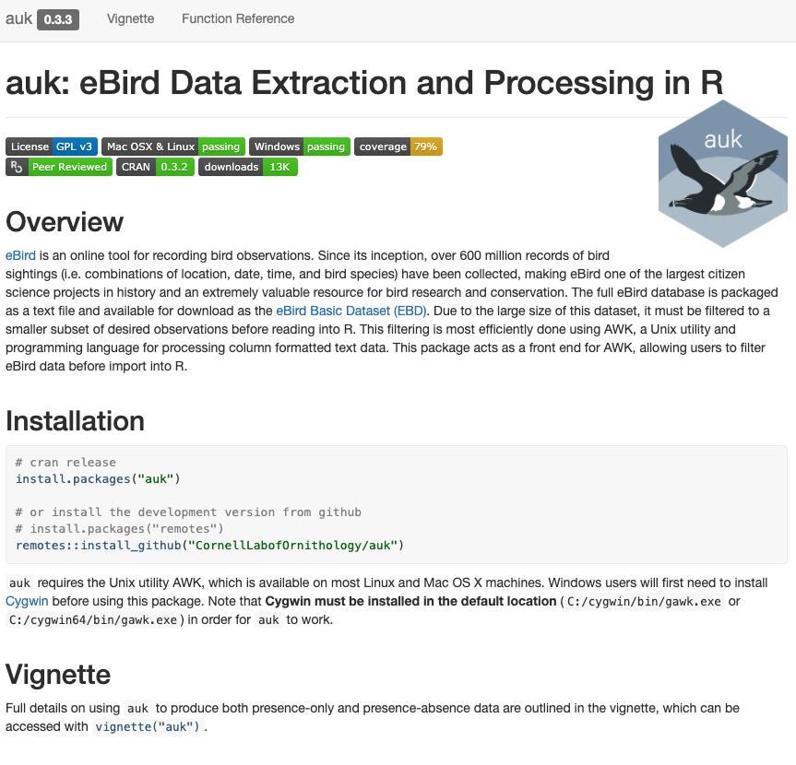


Notes:
We've developed an R package, that uses AWK behind the scenes to extract data from the EBD, but as a user you just write R code so it's much easier to work with

Slide 18
auk workflow
1
data access
2
filter
3
import
4
pre-process
5
presence-absence data
Notes:
Part I of this workshop will focus on auk

Slide 19
Applications
mapping and summarizing
1
occupancy model preparation
2
land cover covariates
3

Slide 20
Workshop format
Participatory live coding
Independent exercises
Post-it notes
Questions
Notes:
Helpers
Experimental

Slide 21
bit.ly/2x2ZAjm
Notes:
Helpers
Experimental

